Slide 1
Degital portfolio
Name :Rekha.K
Reg.no. : 36324u18055
Department : B.sc ( computer science)
College : sree abiraami arts and science College for women
University : Thiruvallur University
Email.id. :rrekha92098@gmail.com

Slide 2

Project title
Problem statement
Project overview
End users
Tooles and technologies
Portfolio design and Layout
Features and functionality
Results and screen shot
Conclusion
Github link

Slide 3

A digital portfolio is like Online showcase of your works , skills and achievements
Instead of carrying files and certificate,everthing is stored neately in one place
Student can use is to display projects, assignments and and extra activities
Job seekers can Share their resumes , certificate and sample Works instently
Teacher and professional can present their research and publications and achievements

Slide 4
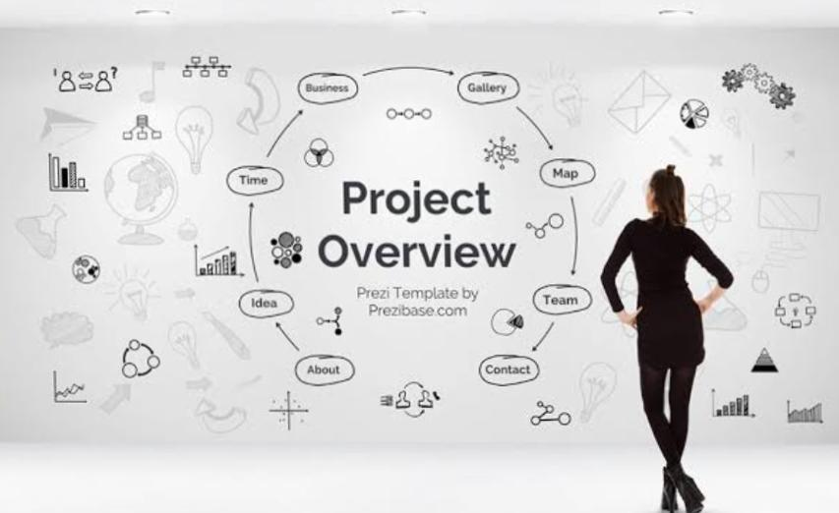
Project overview
The digital portfolio Project is designed to Create an online platform Where users can profectionally showcase their skills, achievements and experiences the system allow students job seekers, and professional to Organize their acadamic records , projects,certifications,and personal details In a structured and appealing format unlike traditional resumes this portfolio highlights creativity and Practice works making it easier to teacher ,employers and peers to under capabilities

Slide 5
End users
Students ( academic project, resume ).
Job seekers (to share with recruiting ).
Freelance (to share with clients).
Professional (to Highlights experience and achievements).

Slide 6
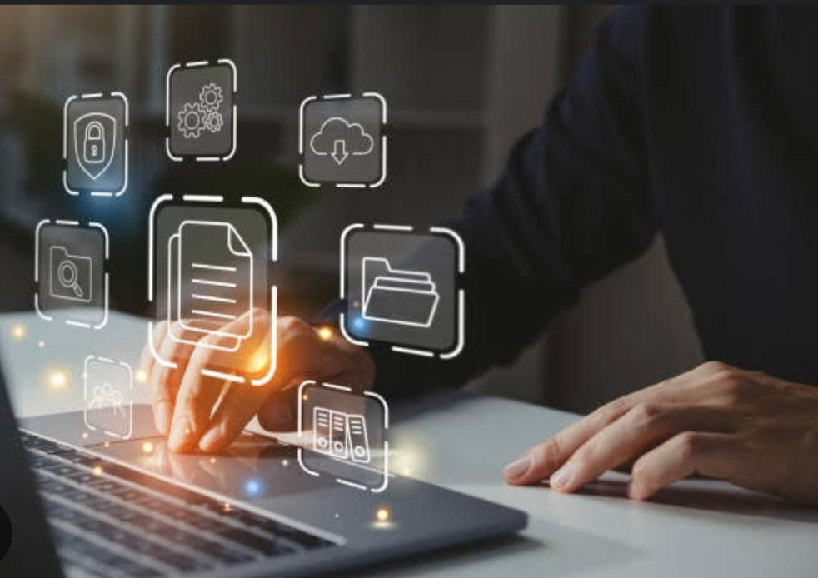
Tools and technologies
HTML5, CSS3, JavaScript – for basic structure, styling, and interactivity. React.js / Angular / Vue.js – for modern, dynamic, and responsive interfaces. Bootstrap / Tailwind CSS – for faster, responsive design and layouts.

Slide 7
Portfolio design and Layout
About Me Skills Projects / Work Samples Resume / Achievements Contact

Slide 8

Features and functionality
User Registration & Login – Secure account creation and access. Profile Management – Add personal details, bio, and contact information. Resume Upload / Builder – Upload or create a professional CV. Project Showcase – Display academic, professional, or creative projects with descriptions, images, or videos. Certificates & Achievements – Upload certifications, awards, and recognitions.

Slide 9

Results and screen shot
About me: I am Rekha k Passionate
Developer focused on responsive design and front
End technologies
Skills : About me: I am Rekha k Passionate
Developer focused on responsive design and front
End technologies
Skills : Certificates:A national level conference about AI
1. Html
2.css
3.javaScript
4.Python
5.c++

Slide 10

Conclusion
The Digital Portfolio serves as an innovative and effective solution for showcasing individual skills, achievements, and experiences in a professional manner. Unlike traditional resumes, it provides an interactive and visually appealing platform where users can present projects, certifications, and personal details in an organized

Slide 11

Github link
Github link :https://Rekha.github.io/Rekhaportfolio/

